Slide 1
Carbon Intensity of a Transportation Fuel: What Is It and Why Does It Matter?
Kristin Henningson – 5/12/2022

Slide 2
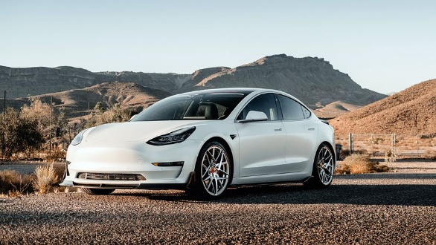
The Reality of Climate Change
We constantly are bombarded by messages about
What we should do or consume…
What we should stop doing or consuming…
How we can contribute to stopping climate from destroying our way of life…
People have opted for many things, including:
Not travelling by airplane
Buying a so-called “zero emissions vehicle”
Recycling everything at home
Shopping less at Amazon to avoid vehicle emissions
Using vegan leather
Notes:
With this basis, I’ll be walking through a few concepts to understand the innovation of low-carbon transportation fuels and why they are important to continue providing affordable energy solutions, protecting our way of life and avoiding dependence on foreign powers.

Slide 3
Audience Poll
Who has heard of the term “Carbon Intensity”?
Who knows what “CO₂e” emissions are?
Notes:
Level-set audience that most will not know these terms

Slide 4
What is CO₂e?
“Carbon dioxide equivalent”
Can be synonymous with “greenhouse gas emissions”
Total representation of greenhouse gas emissions, on a normalized basis
Each greenhouse gas has a global warming potential (GWP) that is determined by the regulatory agency
CO₂e is the sum of emissions of each greenhouse gas multiplied by its GWP

Slide 5
What is CO₂e?
Gas | Global Warming Potential¹
Carbon dioxide (CO₂) | 1
Methane (CH₄) | 25
Nitrous oxide (N₂O) | 298
$${CO}_{2}e=\sum_{i=1}^{n}{{GHG}_{i}×{GWP}_{i}}$$
¹From EPA, 40 CFR 98, Table A-1
CO₂ x 1
CH₄ x 25
N₂O x 298
CO₂e

Slide 6
What is CO₂e?
Example: A unit emits 1 pound of CO₂, 1 pound of CH₄, and 1 pound of N₂O
CO₂ x 1
CH₄ x 25
N₂O x 298
CO₂e
1 lb CO₂ x 1
1 lb CH₄ x 25
1 lb N₂O x 298
324 lb CO₂e

Slide 7
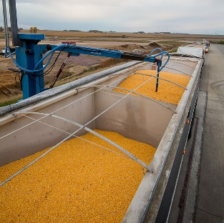
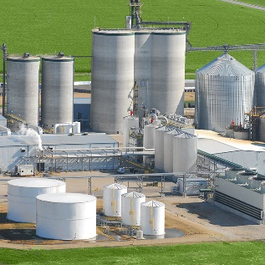
Carbon Intensity of a Transportation Fuel
A calculation of a fuel’s total carbon footprint
“Life cycle analysis”
“Wells-to-Wheels” analysis
From feedstock production through end-use of the fuel
Expressed as CO₂e emissions per unit of energy in the fuel
CO₂e emissions per unit fuel energy
Feedstock Production, Cultivation, Transportation
Production & Distribution of Finished Fuel
End-User Fuel Combustion
Carbon Intensity
Notes:
Explain “wells to wheels”
Emphasize per unit of energy in the fuel. Example is two gallons of fuel – each takes same about of CO2e to produce. One has half of the energy – so it has double the CI
Will discuss all of these parts of the process in more detail in upcoming slides

Slide 8
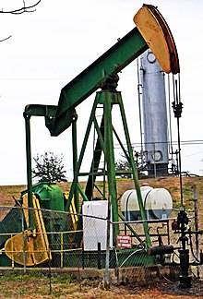
Carbon Intensity of Various Liquid Transportation Fuels
Ethanol
Renewable Diesel
Gasoline / Diesel
Carbon Intensity (~70 gCO₂e/MJ)
Carbon Intensity (~30 gCO₂e/MJ)
Maximize the benefit if these are a waste!
Carbon Intensity (~100 gCO₂e/MJ)
Notes:
Run through each example at a high level. Note and arrows fade in at click!

Slide 9
Carbon Intensity Variables: Corn Ethanol
Feedstock Production Emissions | Transportation Emissions (Feedstock) | Processing Emissions | Transportation Emissions (Finished Product)
Seeding rate Fertilizer use Fuel use Land-use change Yield rate | Distance by mode of transport | Corn usage rate Electricity use Natural gas use Enzyme use Addition of denaturant | Distance by mode of transport
Waste Feedstock
Using waste fiber with additional enzymes
Produces “Fiber Ethanol” with a lower CI
Co-Products
Distiller grains
Corn syrup
Corn oil
Notes:
Discuss a few points on this slide, especially if they come up later
Fertilizer
Land use change
Electricity/NG usage
Transportation

Slide 10
Carbon Intensity Variables: Renewable Diesel
Feedstock Production Emissions | Transportation Emissions (Feedstock) | Processing Emissions | Transportation Emissions (Finished Product)
Farming Oil extraction | Distance, by feedstock, by mode of transport | Feedstock usage rate Electricity use Natural gas use Hydrogen consumption | Distance by mode of transport
Waste Feedstocks
Used cooking oil
Tallow & Yellow grease
Produces renewable diesel with even lower CI
Co-Products
Other renewable hydrocarbons
Notes:
Discuss a few points on this slide
Oil extraction
Hydrogen consumption
Numerous suppliers means large amount of data for transportation

Slide 11
Carbon Intensity Variables: Fossil Gasoline or Diesel
Feedstock Production Emissions | Processing Emissions | Transportation Emissions
Fuel-burning equipment emissions Leaks to atmosphere | Electricity use Natural gas use Fuel gas combustion Refinery process unit emissions Hydrogen consumption | Raw crude Finished fuel
Co-Products
Other fossil fuel products
Notes:
Discuss a few points on this slide
Crude oil extraction
Refinery process emissions
If asked what the CI is for electric, I will state that I’m not an EV expert, but can speak to liquid fuel CI

Slide 12
How Can Carbon Intensity Be Lowered?
Example Variable | Example Reduction Opportunity*
Crude oil transportation emissions | Transportation using a renewable source, such as sail boat
Feedstock source | Using a feedstock that is otherwise a waste can provide a large CI reduction
Hydrogen consumption | Use “green” or “blue” hydrogen, rather than “grey”
Electricity or natural gas usage | Replace outdated equipment with more energy-efficient units
Electricity or natural gas usage | Install a renewable power source (solar, wind) at the plant
Process emissions | Carbon capture and sequestration
*Not an exhaustive list. Provided for example purposes only. Not all models will accept these reduction opportunities.
Notes:
Discuss a few points on this slide
Sail boat transport - California
Animal fats have a very low CI since they are a waste
CCS will be discussed by Title Sponsor in last slot of day

Slide 13
What Are We Missing?
Current transportation fuel carbon intensity models do not account for vehicle life cycle
When full vehicle life cycle is included, emissions from EVs are significant from mining raw materials to fabrication to delivery to the showroom
Fuel Carbon Intensity
Vehicle Carbon Intensity
Full Life Cycle Carbon Intensity

Slide 14
Vehicle Life Cycle
Two times as much CO₂ emissions are generated compared to cars fueled by gasoline
Before it leaves the showroom, 12 tons of CO₂ emissions have already been generated vs. 6 tons of CO₂ emissions from cars fueled by gasoline
Embedded CO₂ Emissions
(zero miles traveled)
Tons CO 12
2
2x higher emissions from mining raw materials to fabrication to delivery
10
8
6
4
2
Car Fueled by Gasoline
Battery Electric Vehicle
Fact: Significant Emissions from EV Life Cycle
Cobalt & Rare Earth Processing
Mining/Extraction
Manufacturing EVs
Power Generation

Slide 15
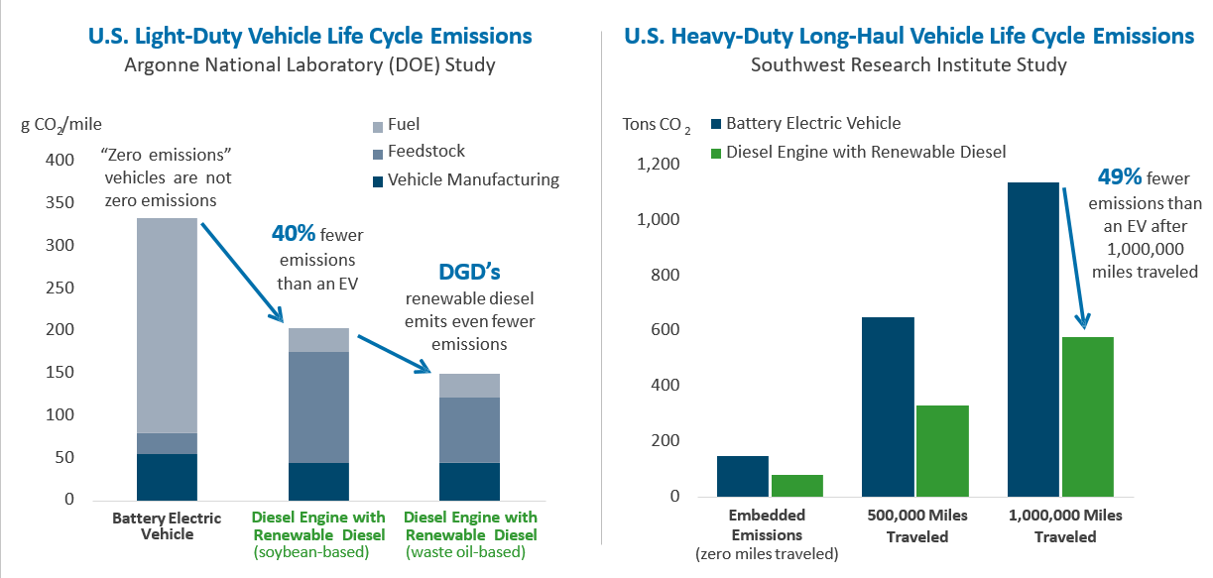
Vehicle Life Cycle

Slide 16
Additional Thoughts
Sustainable Aviation Fuel (SAF)
The same feedstocks used for renewable diesel can be used in sustainable aviation fuel, reducing emissions by ~70%.
The technology is proven and ready to be implemented.
Electric Vehicles
Infrastructure build-out is required from current state.
Potential dependence on foreign powers for 90%+ of the metals needed using current technology.
Online Shopping
Current solutions exist, where retailers opt for low-carbon fuels, like renewable diesel.
No need to wait for larger batteries for long-haul or heavy-duty trucks.

Slide 17
Summary
CO₂e = CO₂ x GWP + CH₄ x GWP + N₂O x GWP
Carbon intensity represents CO₂e per unit of energy in the fuel, for that fuel’s entire life cycle
Current models do not include vehicle life cycle emissions
A full technology-neutral “apples-to-apples” comparison would model both the vehicle and the fuel carbon intensity

Slide 18
Questions and Answers

